Slide 1
The days of Summer by eve bunting and William low
Rich Vocabulary Practice

Slide 2
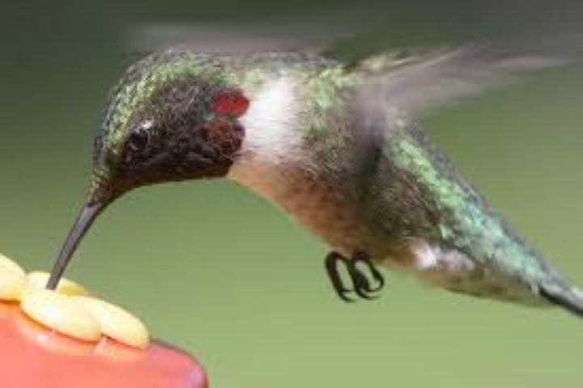
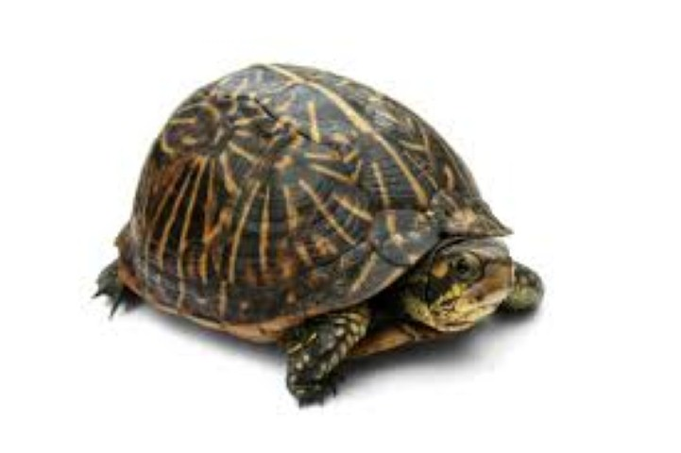
Flutter, fluttering, fluttered
Flutter: To move about quickly
Jo-Jo is so skinny – skinny as the little starling that once flew against our window and that I held for a minute before it fluttered away.
Which animal moves by fluttering? How can you tell the animal would flutter when it moves?
A. B.

Slide 3
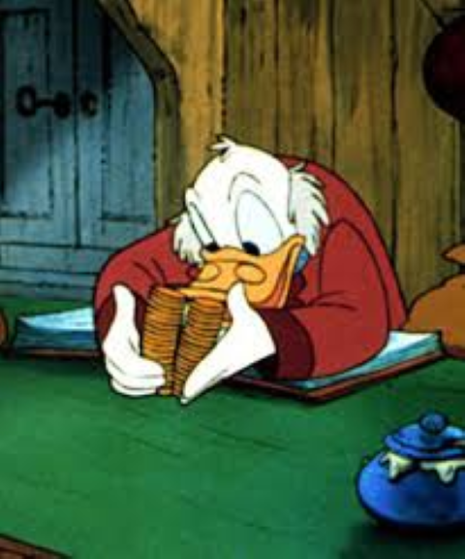
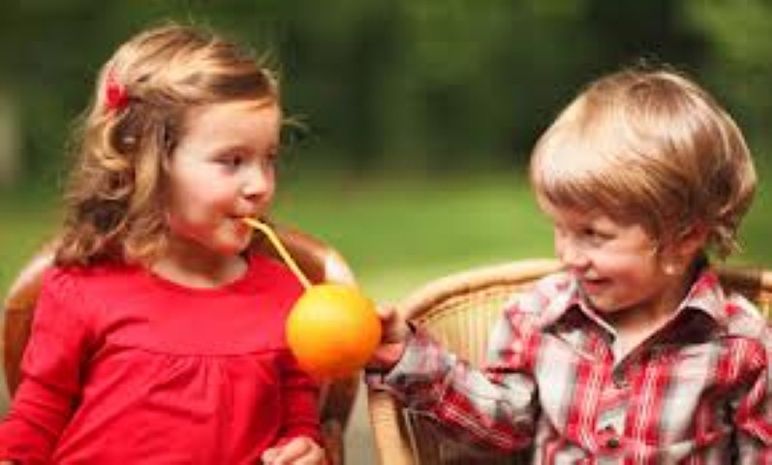
generous
Generous: Giving to others
“I’ve got thirty-three dollars. I’ll give you every bit,” Jo-Jo said.
Grandma hugged us. “That’s so generous of you, Jo-Jo.”
Which picture shows someone being generous. What is generous about the person in the picture?
A. B.

Slide 4
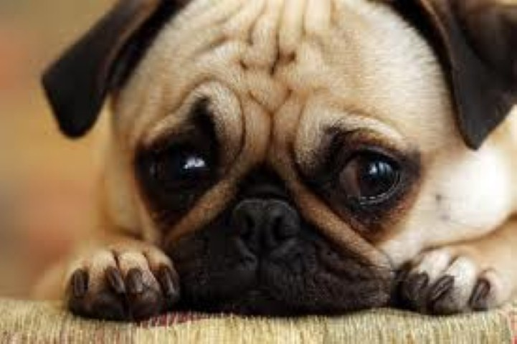
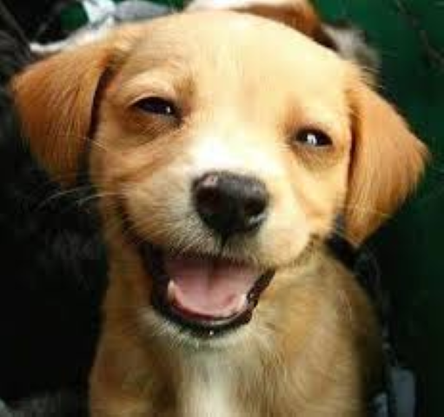
Doleful
Doleful: Full of sadness
“Our last ice cream cone this summer,” I said. “Our last time to feed the ducks this summer,” I said dolefully. Doleful is how I feel right now.
Which picture shows an animal feeling doleful? What is it in the picture that lets you know the animal is doleful?
A. B.

